Slide 1
Bank Marketing Prediction
MIS 436
Yen Vo, Zhan Xu,
Yu Pei, Keegan Wolfe

Slide 2
Background
The data set was collected during the financial crisis 2008 to 2010:
The crisis affected not only in the US banking industry, but also in the European countries, especially in Portuguese.
The Great Recession started to hit Portugal in 2008; that year the Portuguese economy did not grow (0.0%) and fell almost 3% in 2009
After the financial crisis of 2007–2008, it was known in 2008–2009 that two Portuguese banks had been accumulating losses for years due to bad investments, embezzlement and accounting fraud
→ In order to improve their financial situation, Portuguese banking institutions launched a direct-to-direct marketing campaign, which was mainly telephone-based. Bankers need to contact multiple contacts of the same customer in order to access if the product (bank fixed deposit) would be subscribed.
Data Source: 1. “2010–2014 Portuguese Financial Crisis.” Wikipedia, Wikimedia Foundation, 24 Oct. 2021, https://en.wikipedia.org/wiki/2010%E2%80%932014_Portuguese_financial_crisis.

Slide 3
Purposes
Analyzing which groups are more likely to subscribe to a term deposit allows the bank to improve its marketing tactics, attract new customers, and maintain the relationship with its loyal customers.
Specific issues that need to be addressed：
Which clients are more likely to make deposits based on factors: Age, Job, Marital, education, credit in default, having a loan, and house?
Does the previous marketing campaign outcome exist and target the right customers? Can we learn anything from it?
Is telemarketing a good strategy to approach clients?
What is the future marketing strategy for the bank?

Slide 4
Data
01
Age (numeric)
Job - type of job
Marital - marital status
Education
Default - has credit in default?
Housing - has housing loan?
Loan - has personal loan?
Client
02
Last contact of the current campaign
Contact - contact communication type
Month - last contact month of year
Day_of_week - last contact day of the week
Duration - last contact duration, in seconds (This attribute highly affects the output target)
03
Campaign - number of contacts performed during this campaign and for this client
Pdays - number of days that passed by after the client was last contacted from a previous campaign
Previous: number of contacts performed before this campaign and for this client
Outcome: - outcome of the previous marketing campaign
Other attributes
04
Emp.var.rate - employment variation rate - quarterly indicator
Cons.price.idx - consumer price index - monthly indicator
Cons.conf.idx - consumer confidence index - monthly indicator
Euribor3m - euribor 3 month rate - daily indicator
Nr.employed - number of employees - quarterly indicator
Social and economic factors
Notes:
Where? What variables? Sample
size?
Data quality: missing values? Outliers? What did you do about it?

Slide 5
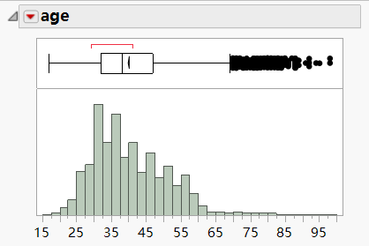
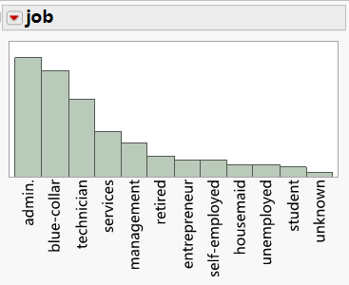
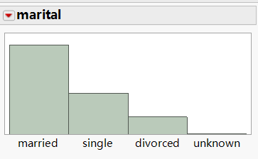
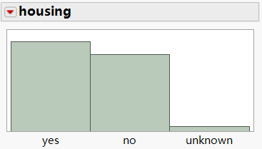
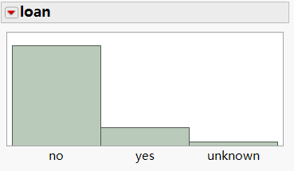
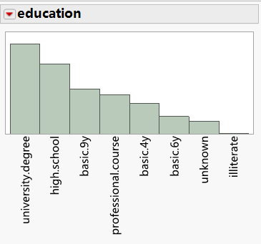
Data- Client
There are 41,188 observations in the data set
No missing value

Slide 6
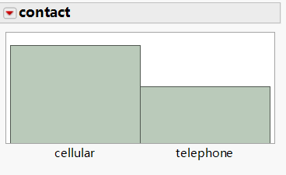
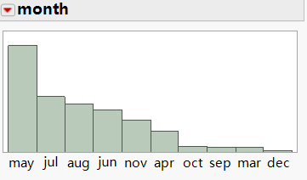
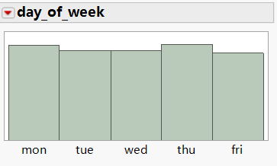
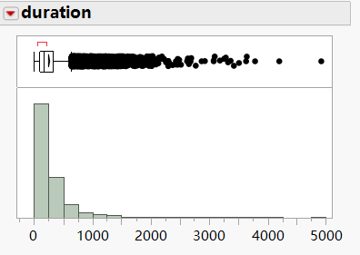
Data - Last contact of the current campaign

Slide 7
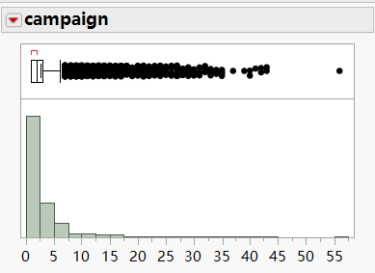
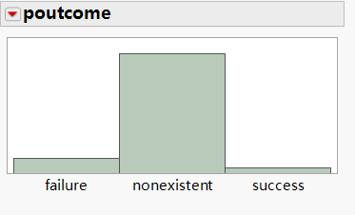
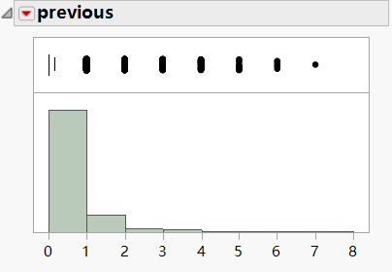
Data - Other attributes

Slide 8
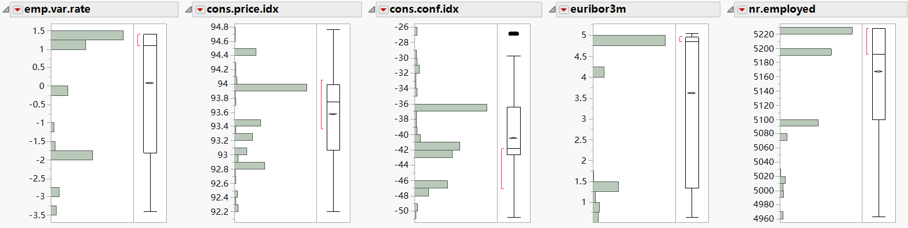
Data - Social and economic factors

Slide 9
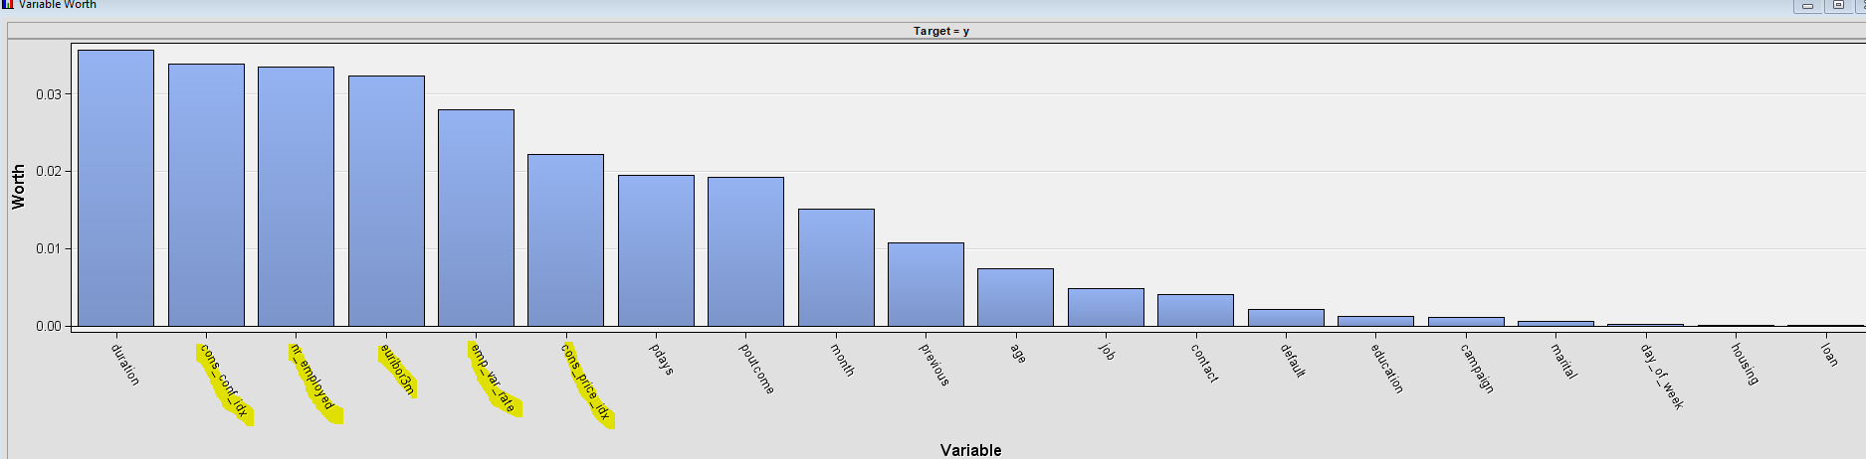
Variables that we don’t use:
04
Emp.var.rate - employment variation rate - quarterly indicator
Cons.price.idx - consumer price index - monthly indicator
Cons.conf.idx - consumer confidence index - monthly indicator
Euribor3m - euribor 3 month rate - daily indicator
Nr.employed - number of employees - quarterly indicator
Social and economic factors

Slide 10
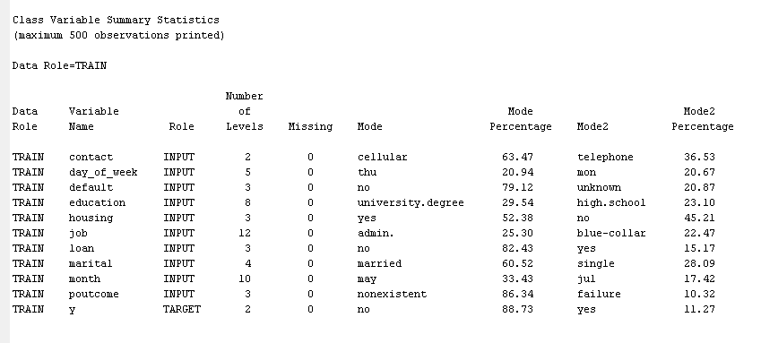
Data: No missing value

Slide 11
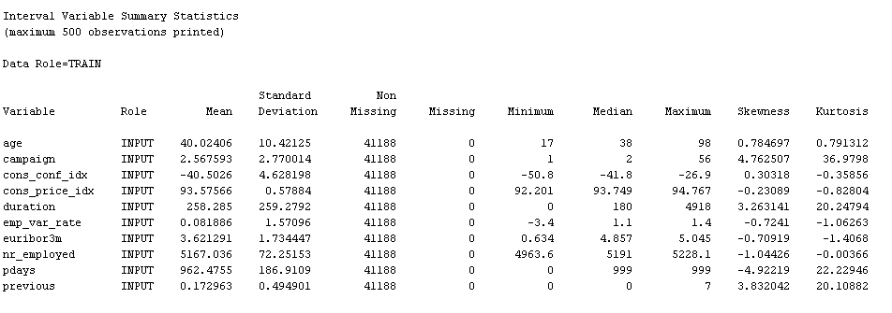
Data- No missing Value

Slide 12
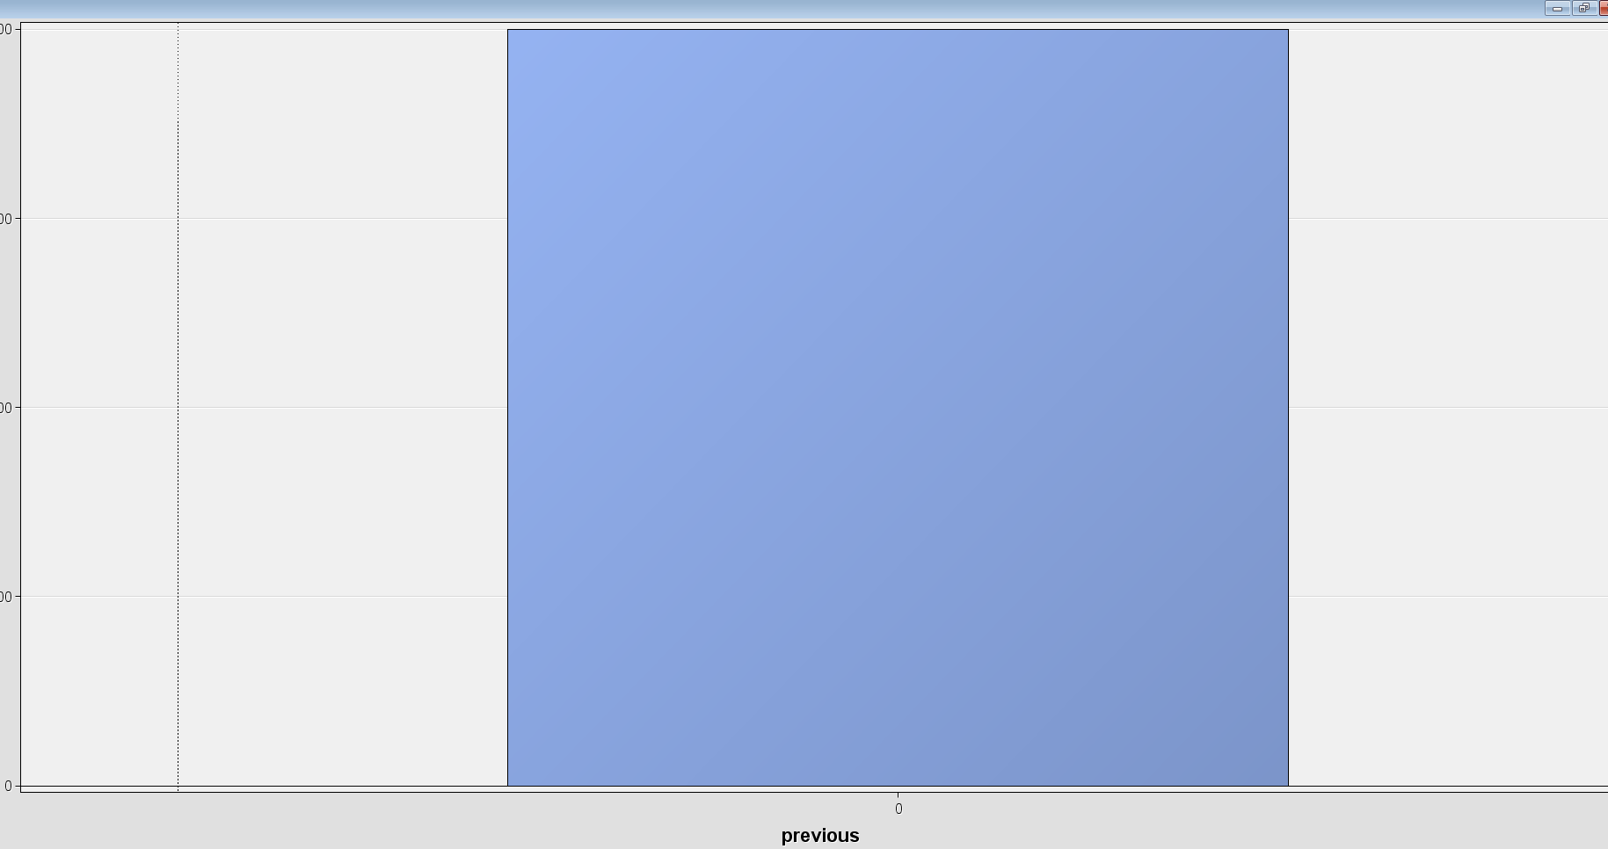
Previous
Previous is the number perform
before and during this campaign for a
Client.
The plot highly concentrate at 0, we can
assume most of the clients are new
→ no need to include this variable in our
data set

Slide 13
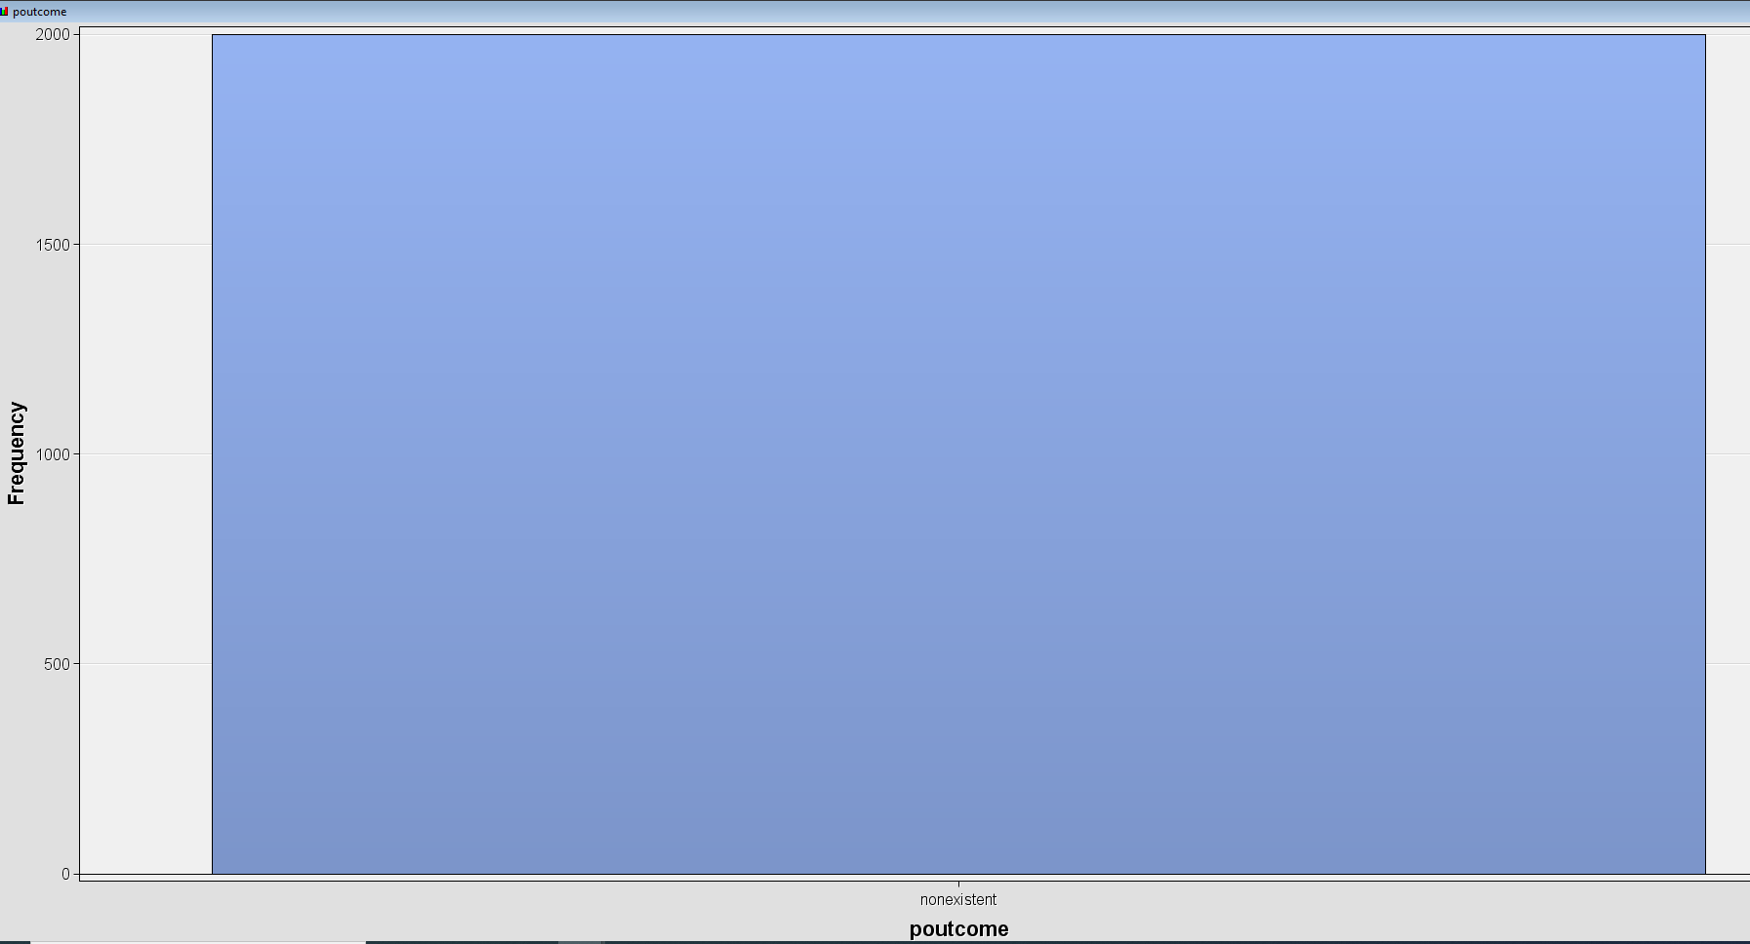
poutcome

Slide 14
poutcome
Outcome from previous marketing campaign
This variable has to be excluded out of the model
The distribution is largely dominated by nonexistent result that means we can’t get any useful information from the previous campaign.

Slide 15
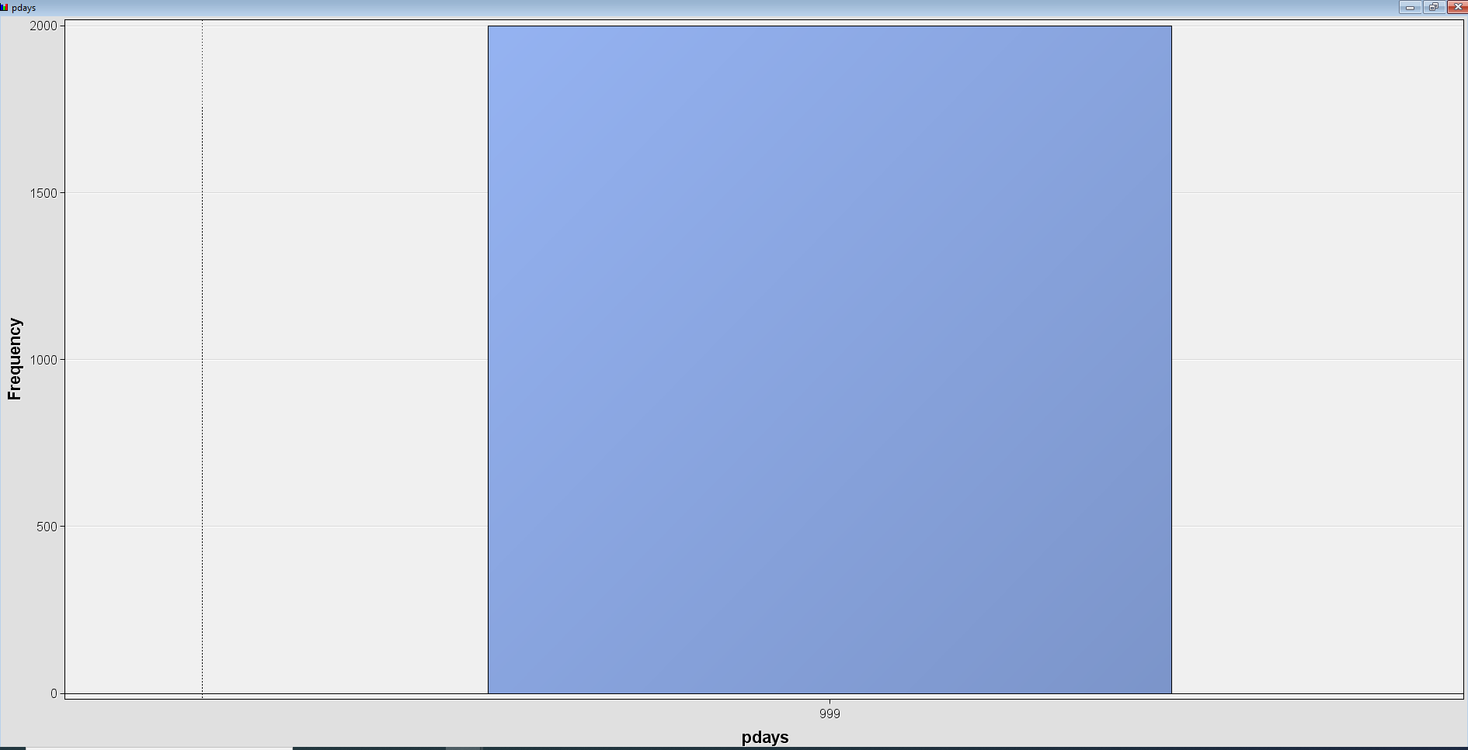

Slide 16
Pdays
The number of days passed by after the client was last contacted from a previous campaign
The graph highly concentrate at 999 that means client was not previously contacted, we can assume all clients are new.
Should be excluded from the model as it doesn’t provide any useful information.

Slide 17
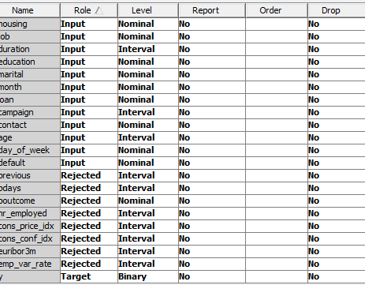
Final variables
Housing
Job
Duration
Education
Marital
Month
Loan
Campaign
Contact
Age
Day_of_week
Default
y= Target ( has the client subscribed to a term deposit?)

Slide 18
Model
Supervised learning: Decision Tree, Logistic Regression, Neural Network
Unsupervised Learning: Clustering

Slide 19
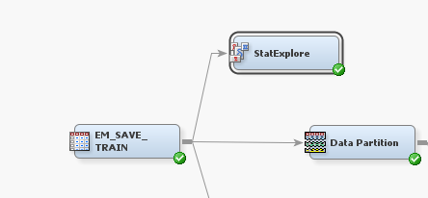
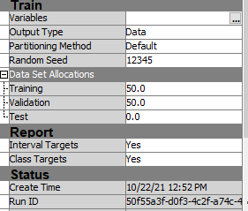
Tools:

Slide 20
Decision Tree
01
02
03
Maximal Tree
Probability Tree
Optimal Tree

Slide 21
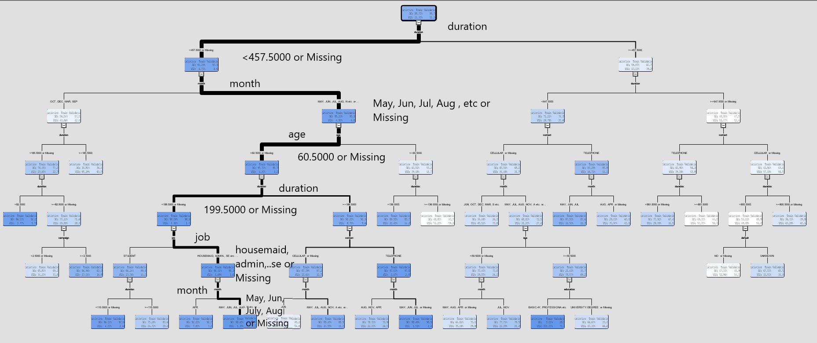
Maximal Tree

Slide 22
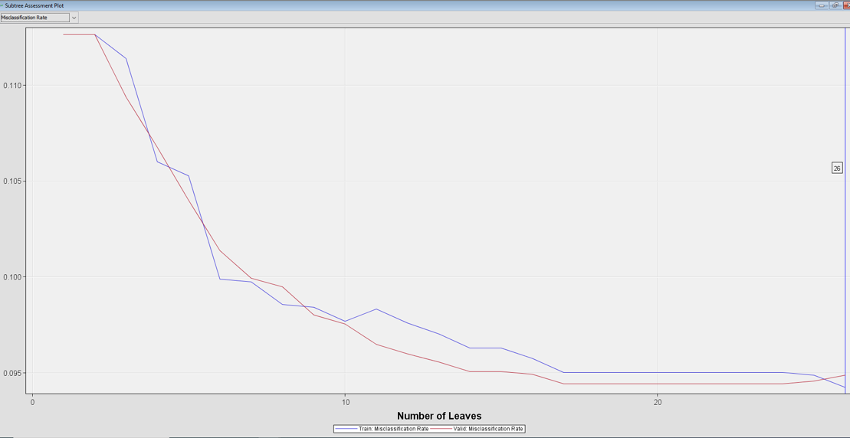
Maximal Tree
26 leaf nodes are generated

Slide 23
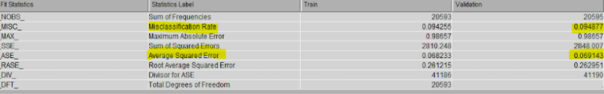
Maximal Tree
We are wrong 9.48% on validation data of the time based on Misclassification rate and 6.91% based on ASE

Slide 24
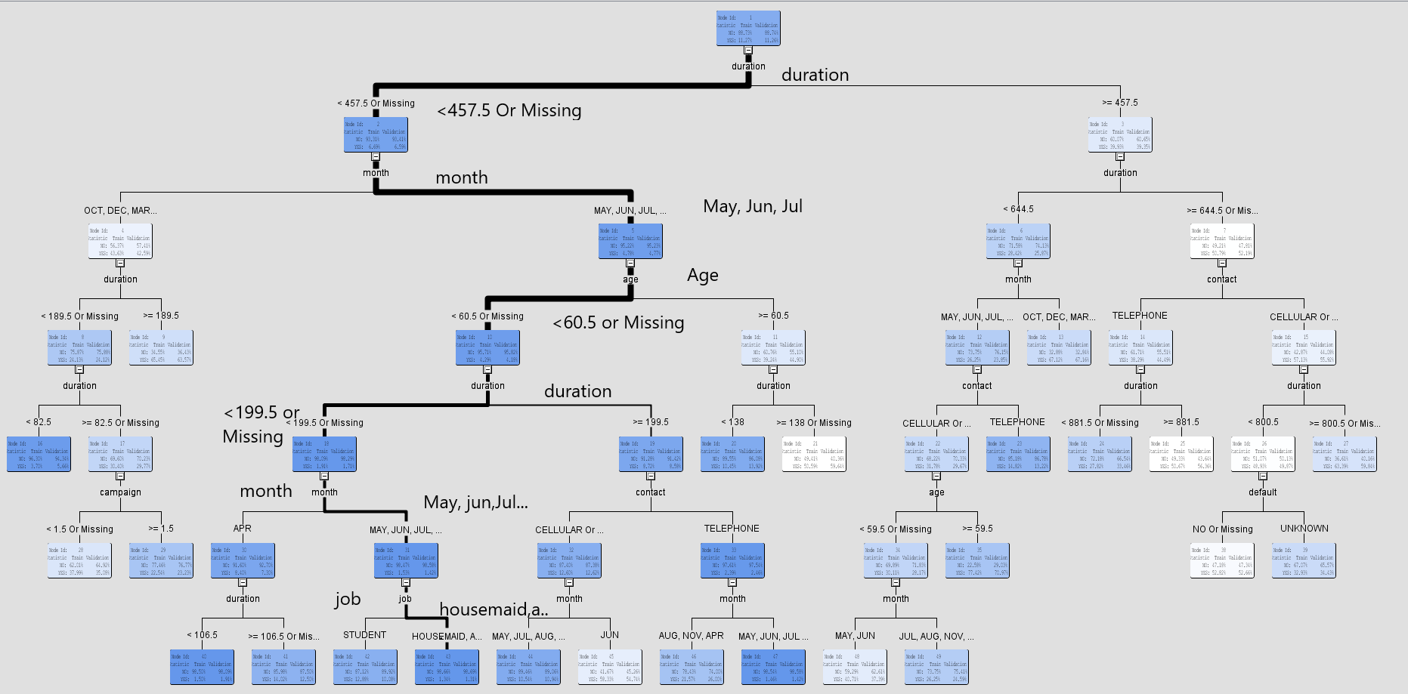
Probability Tree

Slide 25
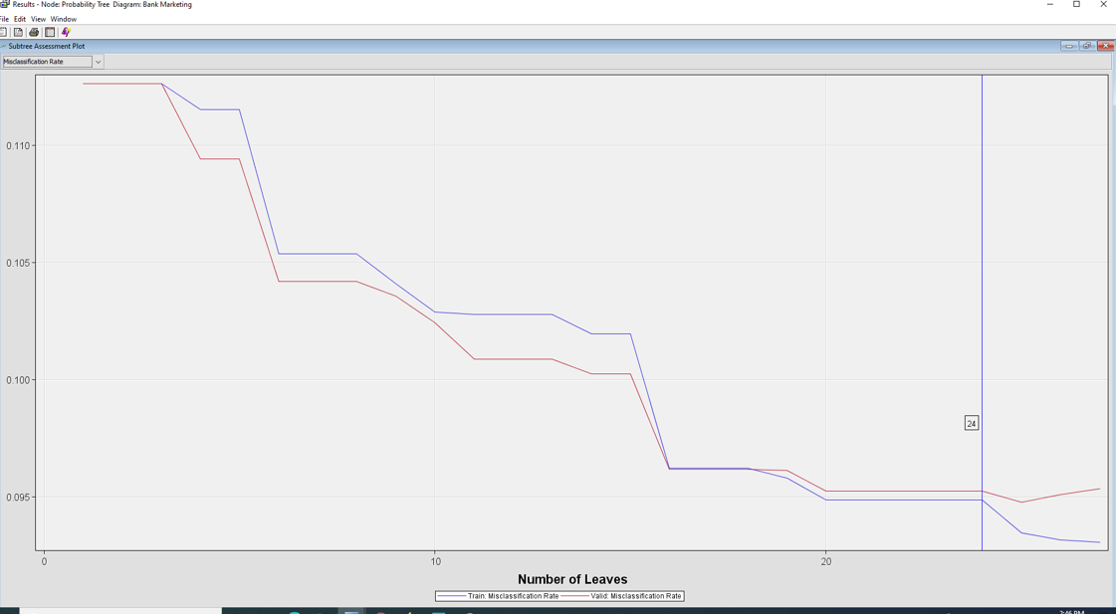
Probability Tree
24 leafs are generated
24 leafs is the best performance

Slide 26
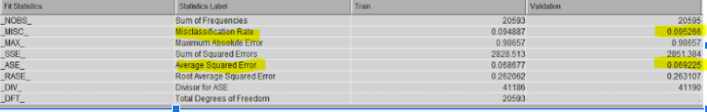
Probability Tree
We are wrong 9.53 % on validation data of the time based on Misclassification rate and 6.92% based on ASE
Slightly higher than Maximal Tree

Slide 27
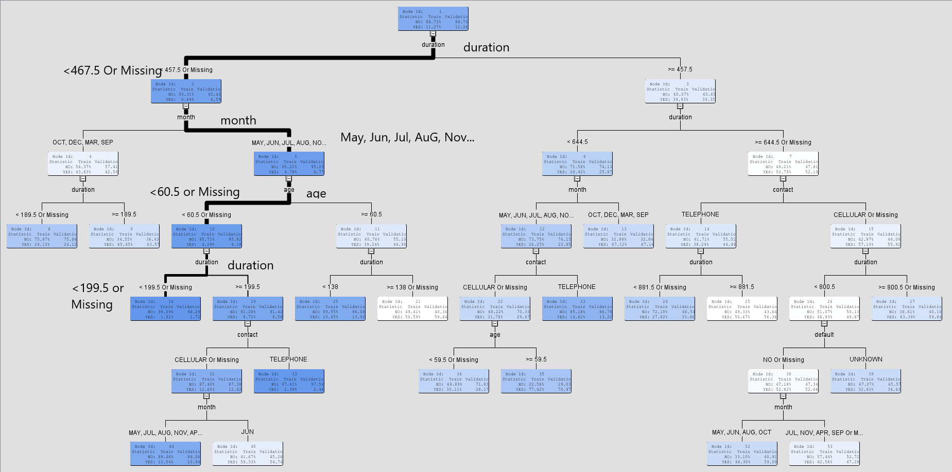
Optimal Tree

Slide 28
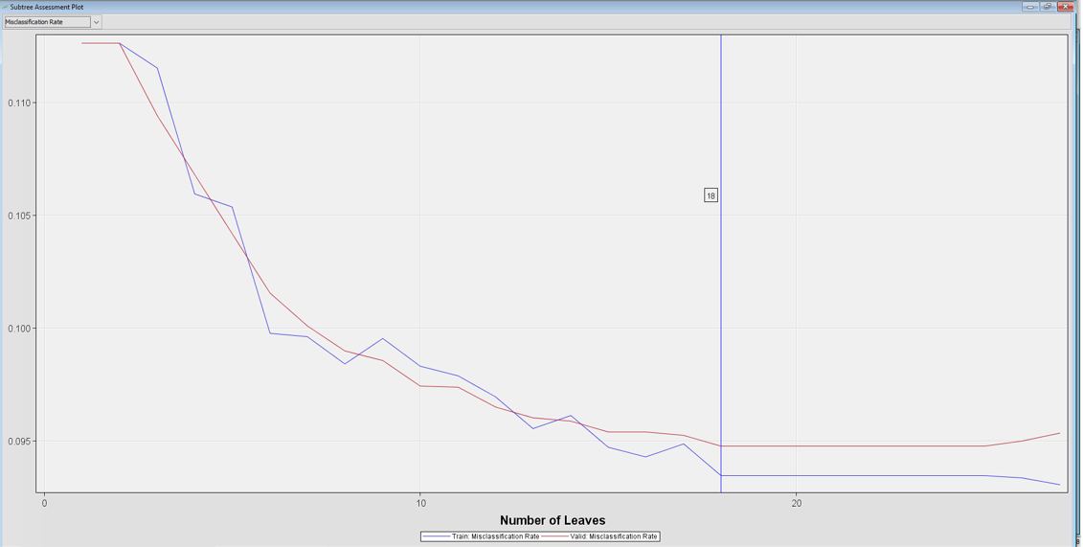
Optimal Tree
18 leafs are generated

Slide 29
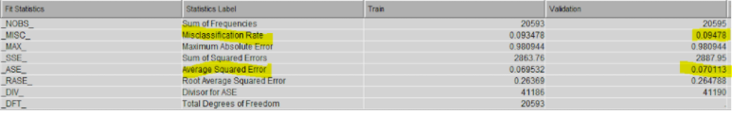
Optimal Tree
We are wrong 9.4 % on validation data of the time based on Misclassification rate and 7 % based on ASE
The misclassification rate slightly lower than both Maximal and Probability Tree, ASE is higher than others

Slide 30
Decision Tree and Key takeaways
Month
Duration
Age
It looks like clients to be more willing to answer the phone during summer months: May, Jun, July, August.
Duration should be fewer than <199.5 seconds ( around 3.325 minutes)
Age < 60.5 years old.

Slide 31
Regression Model
01
02
03
Default Regression
Default Stepwise
Stepwise Misclassification

Slide 32
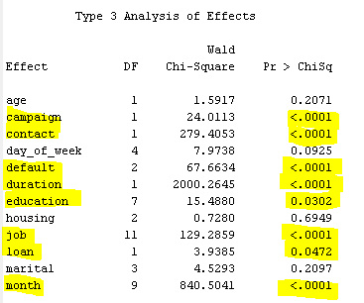
Default Regression
Significant variables that have p value < 0.05:
Campaign
Contact
Default
Duration
Education
Job
Loan
month

Slide 33
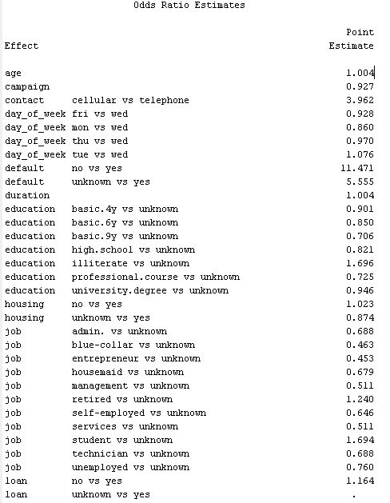
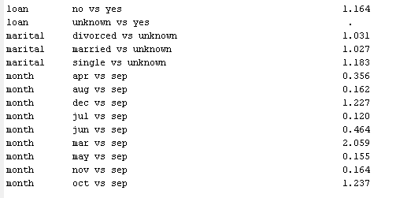
Default Regression

Slide 34
Variables that increases the odd of ratio to subscribe a term of deposit
Age | No loan ( vs yes)
Contact is cellular
Last day contact is Tuesday ( vs Wed) | Dec (vs Sept)
Credit default is no ( vs yes) | Mar (vs Sept)
duration | Oct ( vs Sept)
No housing ( vs yes)

Slide 35
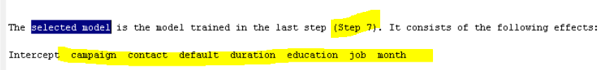
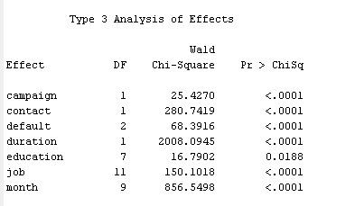
Default Stepwise Regression-

Slide 36
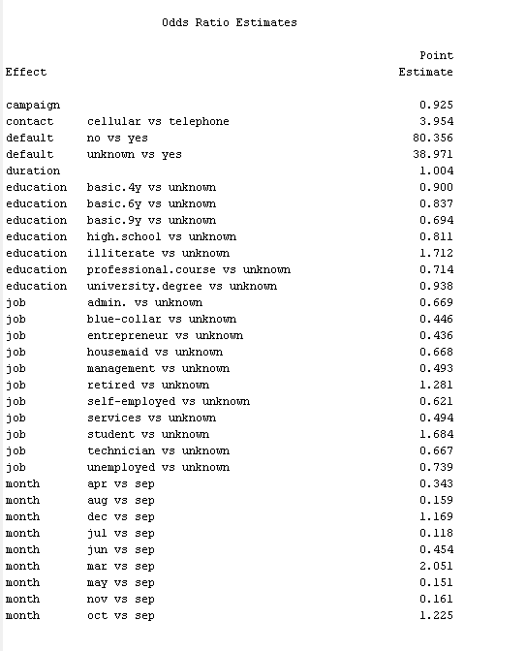
Default Stepwise Regression
Increases the odd of ratio:
Cellular ( vs telephone)
Credit in default ( no vs yes)
Duration
Illiterate (vs unknown)- Excluded
Retired (vs unknown)-Excluded
Student ( vs unknown)-Excluded
Dec( vs Sept)
Mar ( vs Sept)
Oct ( vs Sept)
Unknown means undetermined or missing data

Slide 37
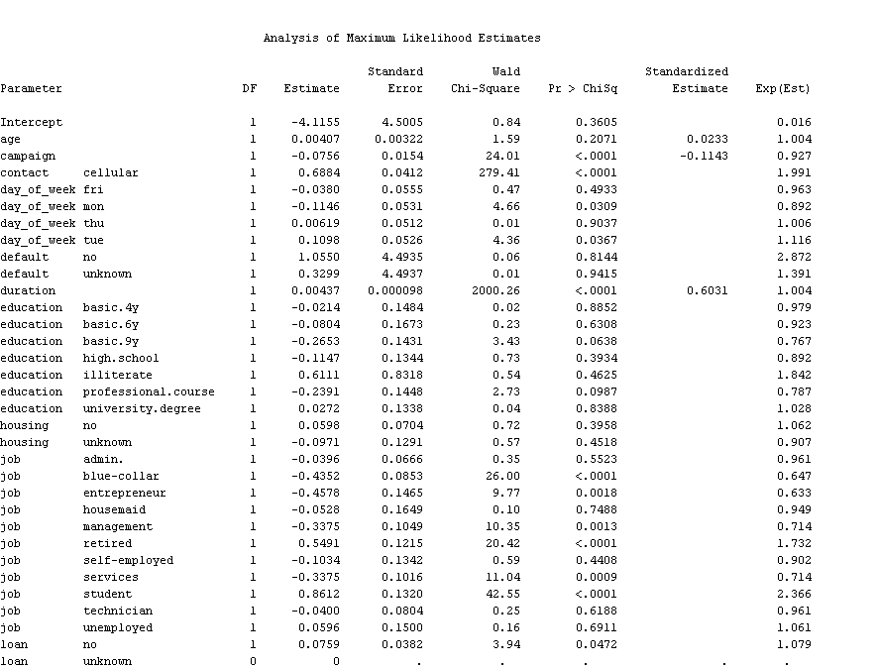
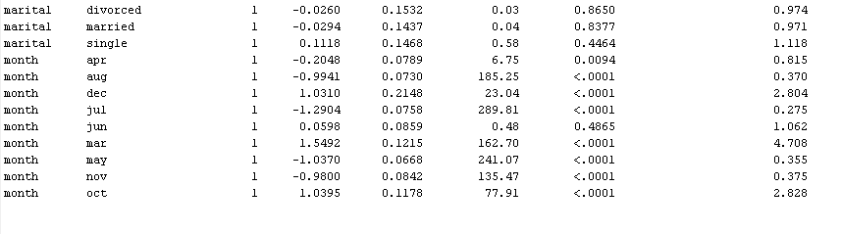
Default Stepwise Regression

Slide 38
Key takeaways from Default Stepwise Regression
01
02
03
04
Contact
Day_of_week
default
Approach clients who using cellular
Call clients on Monday, Tuesday
Not having credit in default
Month
Mar, Oct, Dec ( compared to Sept)

Slide 39
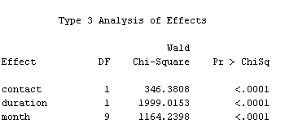
Stepwise Misclassification

Slide 40
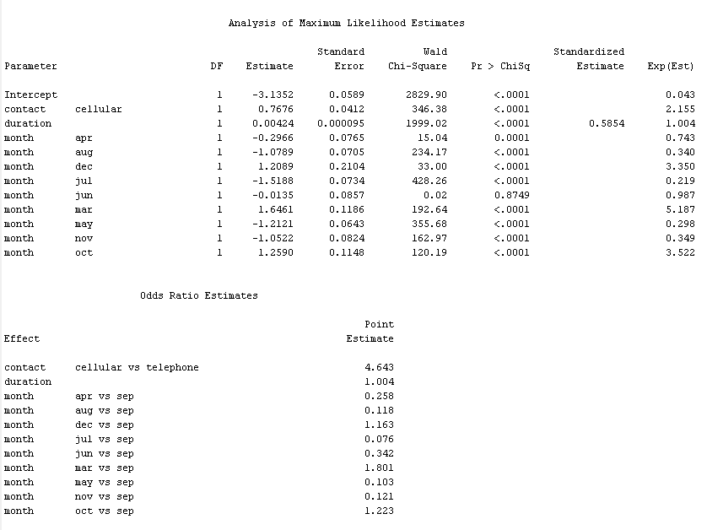
Stepwise Misclassification

Slide 41
Stepwise Misclassification and Key takeaways
Contact
Duration
Month
Approach clients using cellular contact
Increases the duration of call in 1 second, increases the odd of ratio to subscribe term of deposit by 0.04%
Contact customers in December, March, and October increases the odd of ratio to subscribe term of deposit over September

Slide 42
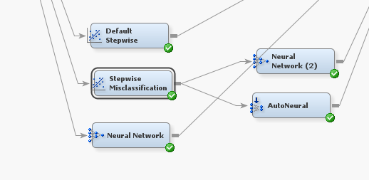
Neural Network
Neural Network
Stepwise Neural
Auto Neural

Slide 43
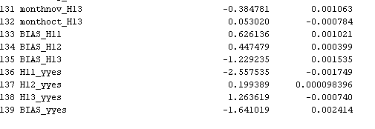
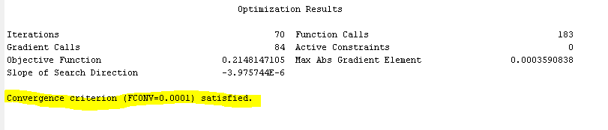
Neural Network
Notes:
3 hidden units

Slide 44
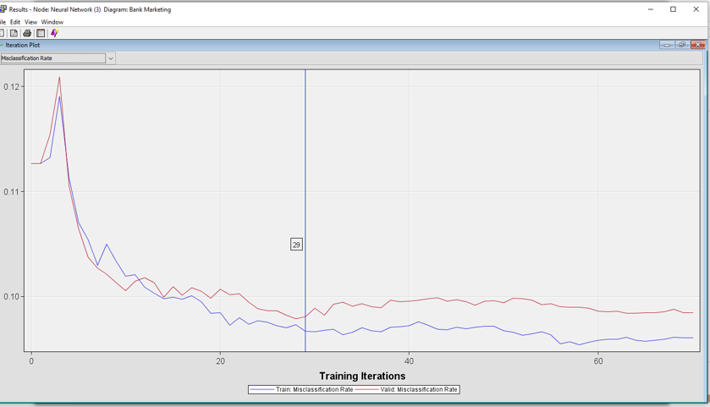
Neural Network- Plot

Slide 45
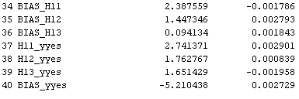
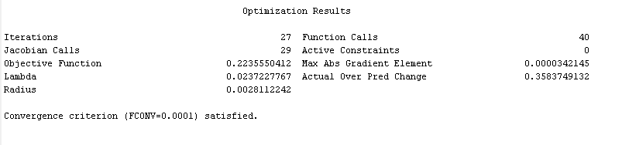
Neural Network Misclassification

Slide 46
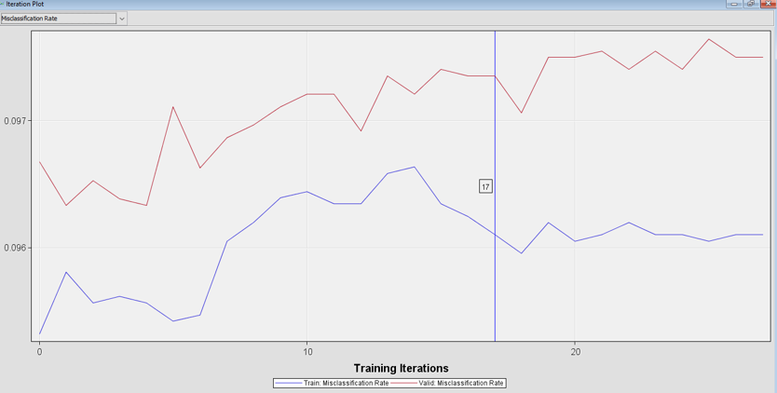
Neural Network Misclassification Plot

Slide 47
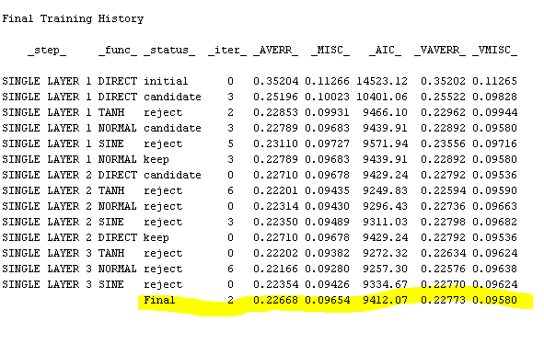
Auto Neural
The final model has 2 hidden units

Slide 48

Auto Neural

Slide 49

Result from Model Comparison

Slide 50

Result from Model Comparison based on ROC
Neural Network has highest ROC number

Slide 51


Slide 52

Clustering
Segment 6 is the most important segment:
The clients aged around 40 years old.
They had been contacted twice during the campaign.
The duration of call was 187.4076 seconds ( 3.12 minutes).

Slide 53



Slide 54

Notes:
The blue bar describes the distribution of duration and campaign. The red bar describes the distribution of duration and campaign in the entire of segment
The 6th segment contains the bank representative had a longer duration with a customer than average. The number of contacts performed during this campaign and for this client ( campaign) is higher than average
The 2nd segment contains the bank representative has a lower duration with a customer than average
The Other segment contains the number of contacts during this campaign for a client is lower than average.

Slide 55
Data Interpretation
The blue bar describes the distribution of duration and campaign. The red bar describes the distribution of duration and campaign in the entire of segment
The 6th segment contains the bank representative had a longer duration with a customer than average. The number of contacts performed during this campaign and for this client ( campaign) is higher than average
The 2nd segment contains the bank representative has a lower duration with a customer than average
The Other segment contains the number of contacts during this campaign for a client is lower than average.
Notes:
The blue bar describes the distribution of duration and campaign. The red bar describes the distribution of duration and campaign in the entire of segment
The 6th segment contains the bank representative had a longer duration with a customer than average. The number of contacts performed during this campaign and for this client ( campaign) is higher than average
The 2nd segment contains the bank representative has a lower duration with a customer than average
The Other segment contains the number of contacts during this campaign for a client is lower than average.

Slide 56

Notes:
Duration are the most important variable, followed by campaign

Slide 57

Problem of the models
There is a bias result between Yes vs No in Decision Tree
We used Regression in our final model to predict the target variable and still keep Decision Tree results for future reference.

Slide 58
Conclusions
Which clients are more likely to make deposits based on factors: Age, Job, Marital, Education, credit in default, having a loan, and house?
- The bank should approach segmentation of clients around 39 - 40 years old, had been contacted twice during the campaign, and the length of phone call around 187.4 seconds ( 3.2 minutes).
- Single people were slightly more likely to make a deposit compared to married and divorced couples.
- Anyone who has credit in default is very unlikely to make a deposit. Not having a loan or not having a house also had a slight effect on deposits.
- Because the results from Regression Model compared Age, Job, Marital, and Education to unknown ( missing values), the results are not meaningful to interpret.
Can we learn anything from the previous marketing campaign?
- Previous campaign was unhelpful, and the data was excluded from the models.
Is telemarketing a good strategy to approach clients?
- Telemarketing proved to be effective, with the months of December, October and March ( compared to September) being the most effective months.

Slide 59
Business Recommendations
Focus should be on any combination of the following:
Single people
Not a homeowner
No existing loans
No credit in default
Contact the clients on Monday and Tuesday will yield better results.
Contact the clients on October, December and March
Approach segmentation of clients around 39 - 40 years old, had been contacted twice during the campaign, and the length of phone call around 3.2 minutes.

